Slide 1
Software Lab Presentation - Group 25
Munich, 18 July 2025
TUM School of Engineering and Design
Speaker: Nien-Ying (03803153)

Slide 2

Festo Plant for Discrete Manufacturing:
Developing Simulation Models for Industrial Copilot
Presentation by MSc. Computational Mechanics students:
Adrián Almohalla (03804037)
Eduardo Silva (03805057)
Nien-Ying Lin (03803153)
Monitored and coordinated by:
Mohamed Khalil
Speaker: Nien-Ying (03803153)

Slide 3





Quick Recap
Overview
Dataset Explained
Degradation Tool
Agentic System
Next Steps & Timeline
Speaker: Nien-Ying (03803153)

Slide 4
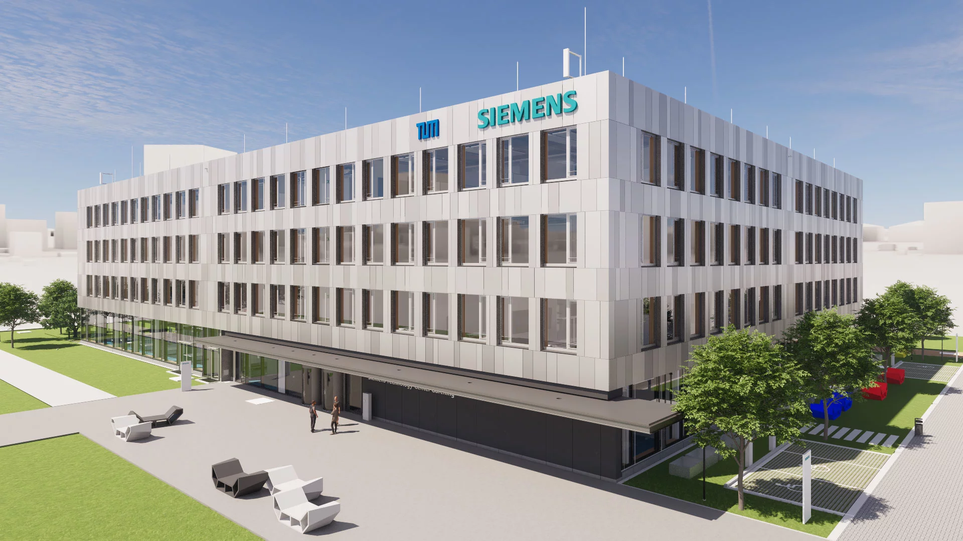

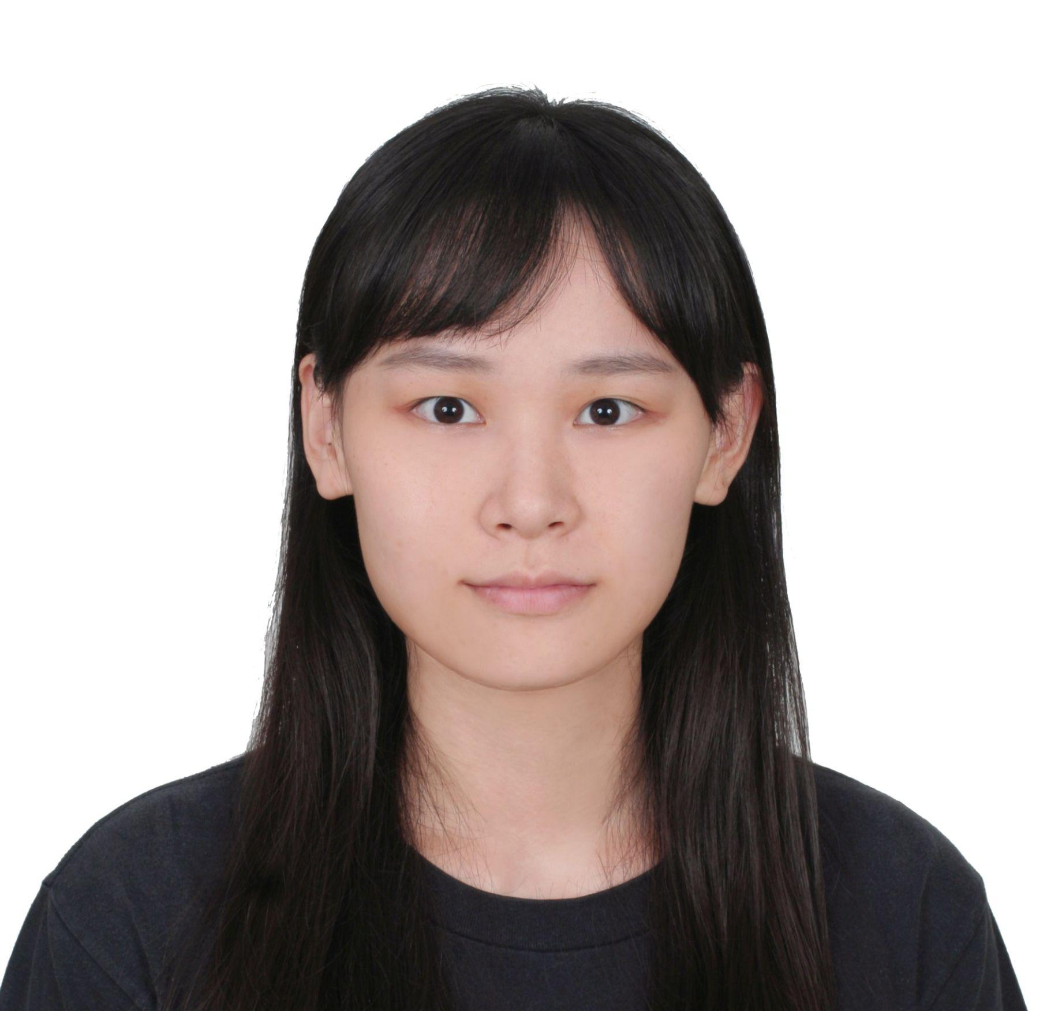



Quick Recap About Team
Siemens Technology Center (Garching)
Eduardo Silva
Nien-Ying Lin
Mohamed Khalil
khalil.mohamed@siemens.com
Adrián Almohalla
Speaker: Nien-Ying (03803153)

Slide 5
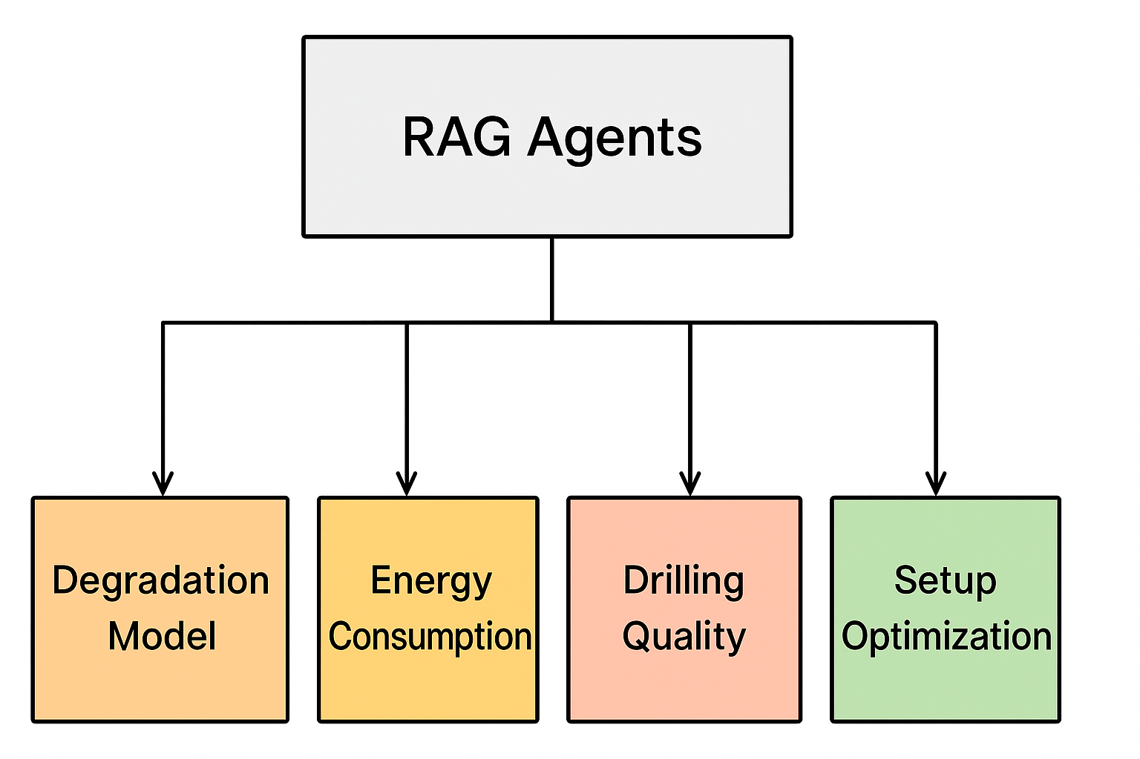
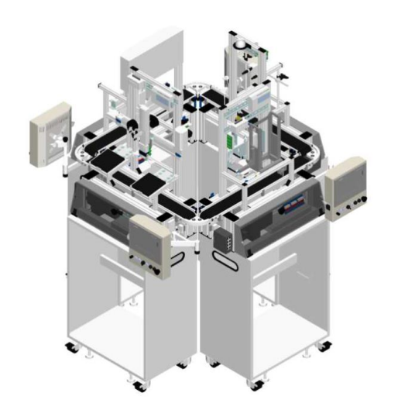
Quick Recap About Problem
Problem:
Manufacturing involves process (feed rate, torque) and product (material) parameters
Existing simulation tools are complex and not accessible to non-experts.
Fig. 2 - RAG-LLMs Tools
Fig.1 - Festo Plant Drilling Station
Speaker: Nien-Ying (03803153)
Notes:
Explain here what the problem is.
Use the documents from Siemens that they gave us for the software lab to explain what the problem is.

Slide 6





Example User Case
“What is the expected energy consumption for a drilling process using an 14 mm drill bit on a copper plate? And how does it change with time?
“How much wear can I expect this production order to cause to my drilling tools?
“If I use X material, how does it change the quality of my drilling? And how can I optimize it?”
Fig. 3 - User Case Icons
Speaker: Nien-Ying (03803153)

Slide 7
Dataset Overview
[1]
Feature | Unit | Description
ID | — | Unique identifier for each row
vc (Cutting speed) | m/min | Generated: Walter GPS
n (Spindle speed) | 1/min | Calculated: (vc × 1000)/(π × D)
f (Feed) | mm/rev | Generated: Walter GPS
vf (Feed rate) | mm/min | Calculated: f × n
Pc (Power) | kW | Calculated: (F × vc)/1000
Cooling | % | Assigned: 0, 25, 50, 100
Material | — | Assigned: P(C45K), K(GJL-250), N(AlSi alloy)
Drill Bit type | — | Assigned(DIN 1836): N(for C45K), H(for GJL-250), W(for AlSi alloy)
t (Process Time) | sec | Generated: Walter GPS
20,000 synthetic drilling operations
Each row contains:
10 features, 5 failure labels
Fixed drilling target: blind hole (⌀12 mm, depth 60 mm)
Failure Labels | Unit | Description
Main Failure | binary | Rule-based: 1 if any subgroup failure occurs
Build-up Edge | binary | Rule-based: Low vc + low cooling
Compression Chips | binary | Rule-based: ≥2 of: high vf, low cooling, wrong bit
Flank Wear | binary | Rule-based: High vf + low vc
Wrong Drill Bit | binary | Rule-based: Bit–Material mismatch
D: drill bit diameter, F: drilling force
Speaker: Nien-Ying (03803153)

Slide 8
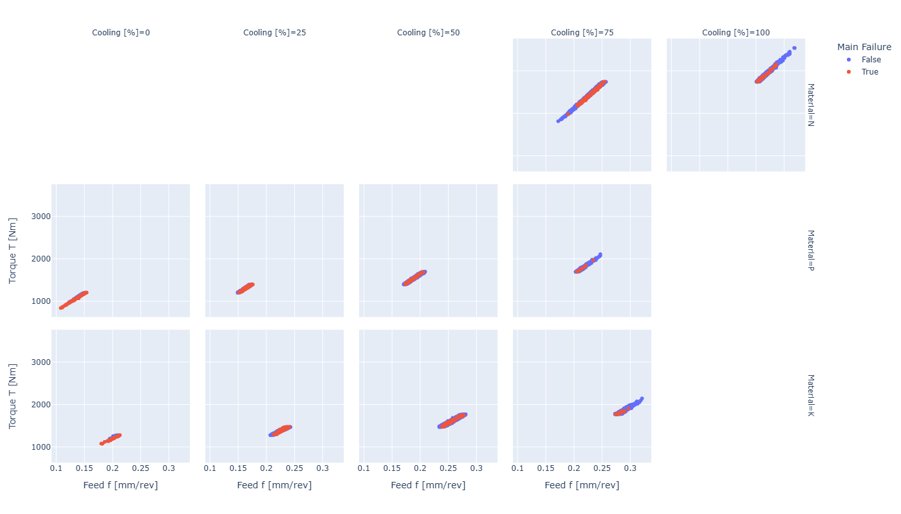
Torque vs. Feed
Cooling
To observe how torque varies with feed, and whether this relationship is influenced by:
Material type (N, P, K)
Cooling level (0, 25, 50, 75, 100%)
Main failure occurrence (True / False)
Material
Torque [Nm]
Feed [mm/rev]
Fig. 4 - Torque vs. Feed across materials and cooling levels, colored by failure status.
Speaker: Nien-Ying (03803153)

Slide 9
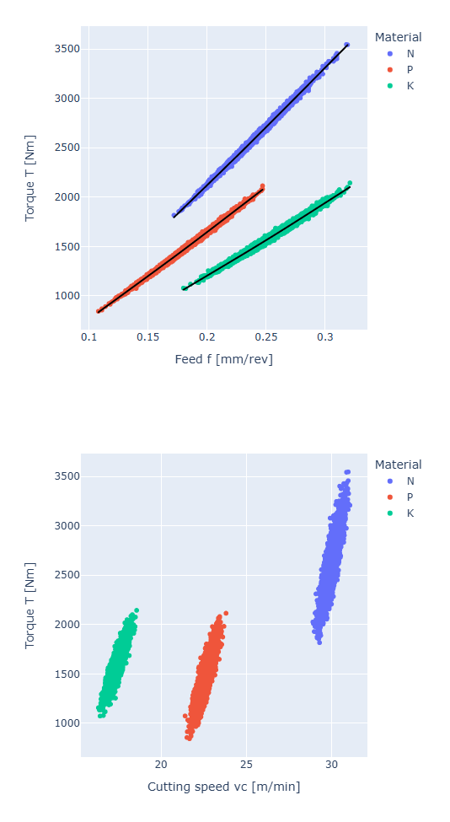
Torque vs. Feed & Cutting Speed
To observe torque is affected by:
Feed (left)
Cutting speed (right)
under different materials (N, P, K).
Conclusions
Torque increases linearly with feed.
Cutting speed also influences torque, but much less than feed.
Fig. 5 - Torque vs. Feed and Cutting Speed, colored by Material
Speaker: Nien-Ying (03803153)

Slide 10
Torque Regression
Model: Linear Regression (Implemented in Python using Scikit-learn)
Features:
Feed f [mm/rev]
One material property ( Hardness [Brinell], Young's Modulus [GPa], Poisson’s Ratio )
Target (Label):
Torque (calculated from power and spindle speed)
Features | R² Score | Coefficients (Feed / Property) | Comment
Feed, Hardness | 0.8925 | +2338.64 / −9.98 | Stable model with good accuracy
Feed, Young’s Modulus | 0.6813 | −756.90 / −9.73 | Low R²
Feed, Poisson’s Ratio | 0.9935 | +8570.38 / +15984.66 | High R² but very large coefficients
Torque [Nm] = 2727.15 + 2338.64 × Feed f [mm/rev] + -9.98 × Hardness [Brinell]
Speaker: Nien-Ying (03803153)
Notes:
higher hardness gives lower torque, because in this dataset, harder materials like cast iron are easier to cut, while softer and more ductile materials like aluminum alloys create more cutting resistance.

Slide 11
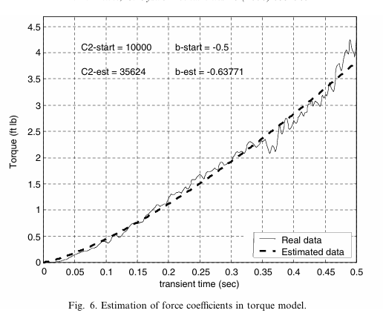
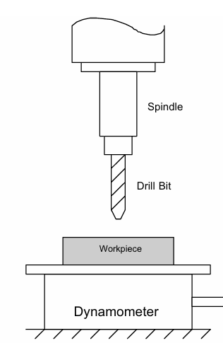
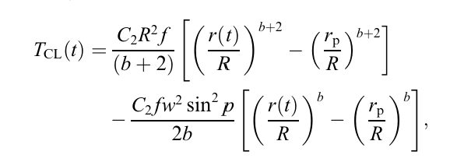
Degradation Tool
[1]
Speaker: Adrián (03804037)

Slide 12
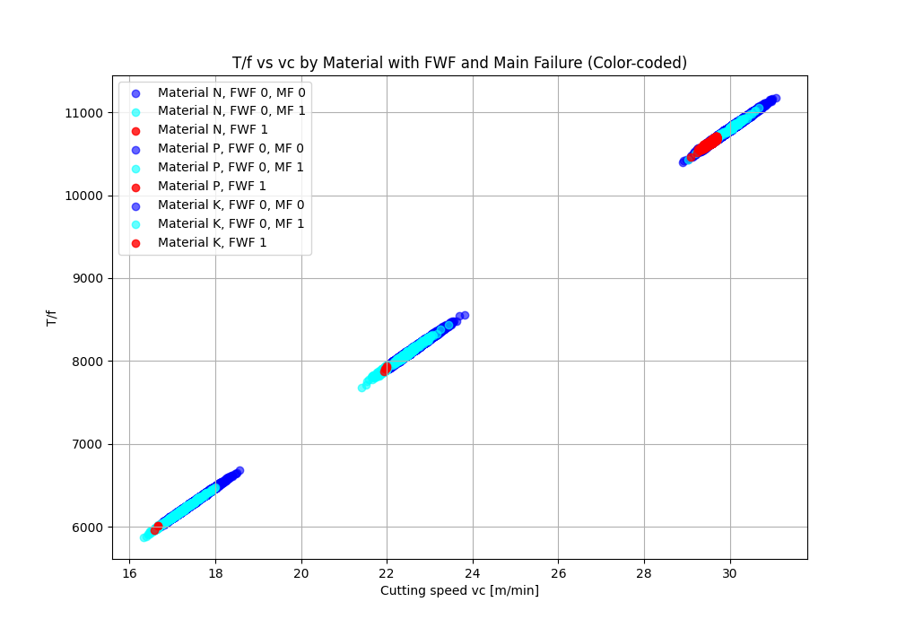
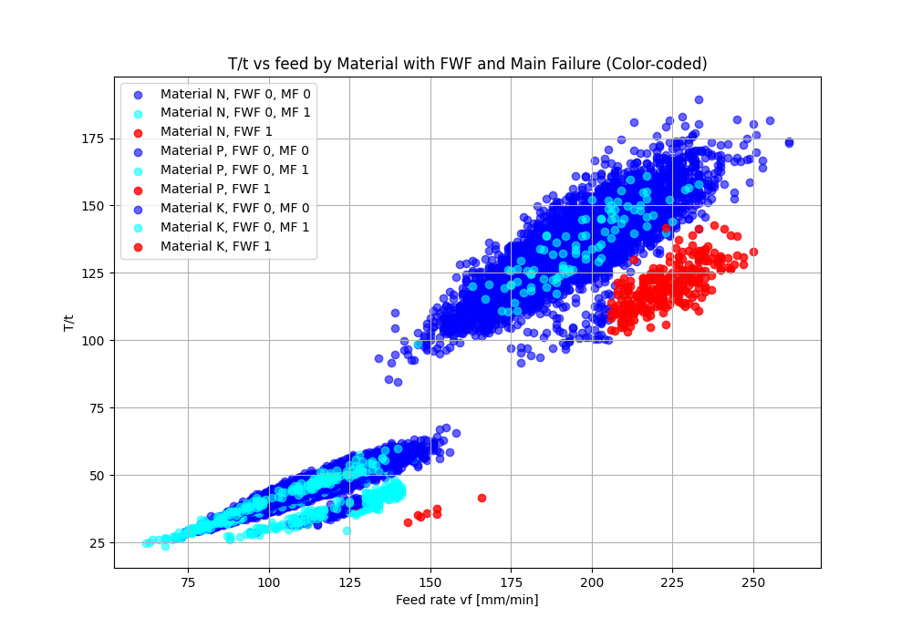
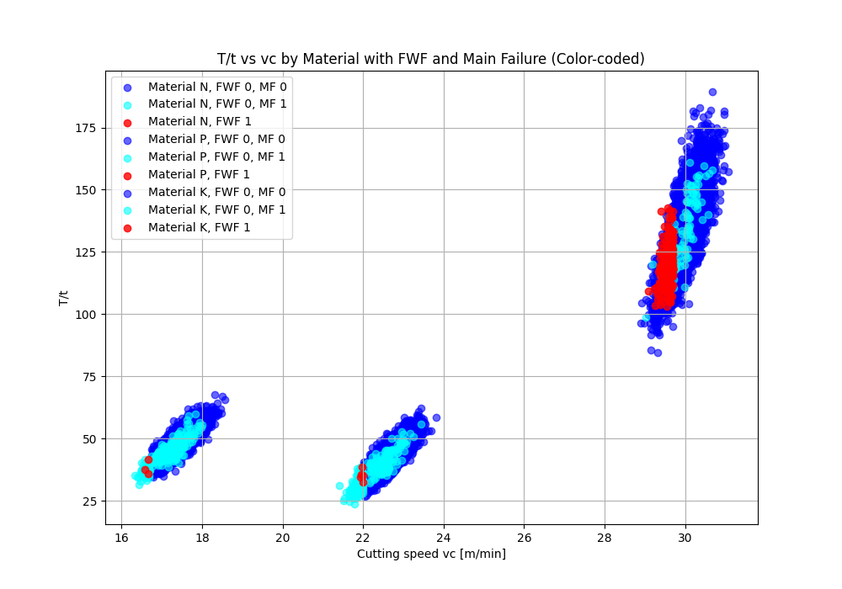
Degradation Tool
New form of estimating wear:
Look for best correlation between material and, properties and Failure.
FWF =1 => 100% wear
Fig. 6 - Degradation Tool Options
Speaker: Adrián (03804037)

Slide 13
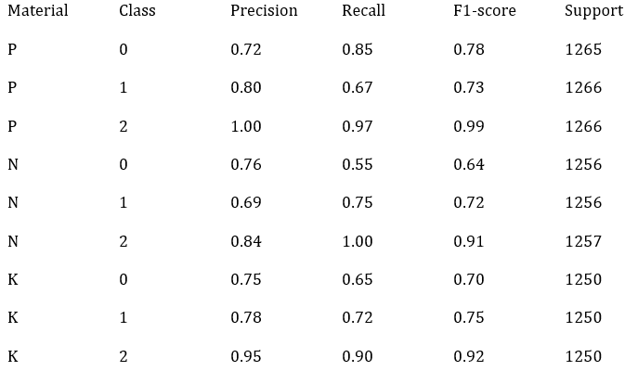
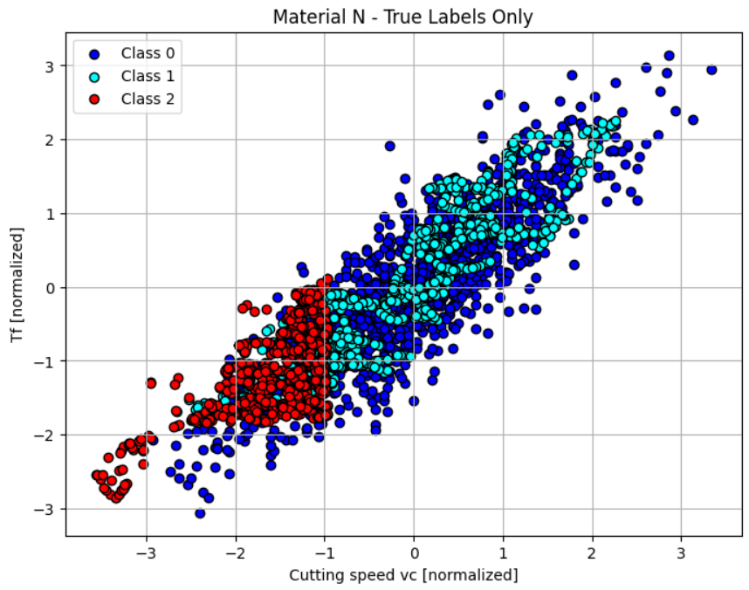
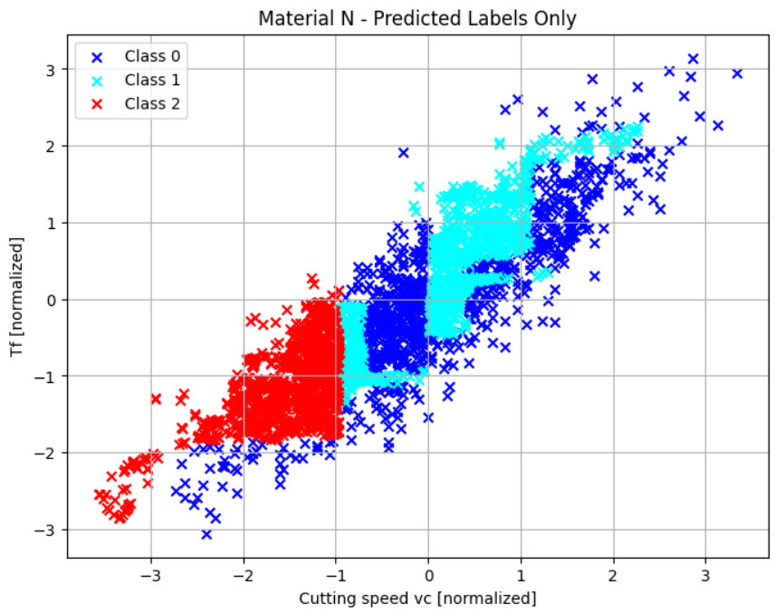
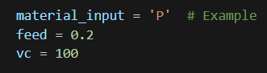
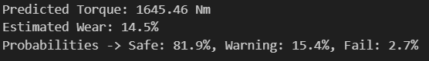
Degradation Tool
For each material:
- A Linear Regression model for Torque prediction.
- An XGBoost Classifier for predicting wear zones (3 classes). We use SMOTE to balance class distribution.
Training models quality and example for an input:
Fig. 7 - Failure Criteria
Speaker: Adrián (03804037)

Slide 14
Future Tools and Improvements with Degradation
Degradation model
Energy consumption model
Provided model by Siemens
Connect it with the LLM
Speaker: Adrián (03804037)

Slide 15
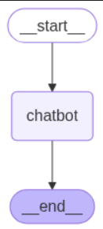




LangGraph Agent System - ChatBot
Creating a simple ChatBot model.
Usage of open-source & free models collection Ollama. [2]
Skeleton of structure to build on top of.
Fig. 8 - ChatBot Case
Speaker: Eduardo (03805057)

Slide 16
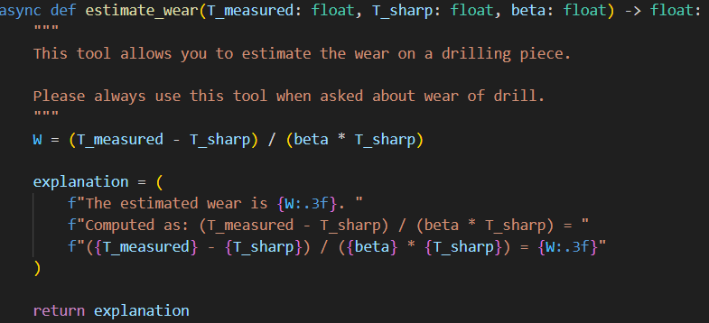
LangGraph Agent System - Dummy Tool
Creation of a dummy tool to test implementation.
Inputs and functionality comments needed.
Return as explanation highly improves results!
After tools are developed, easy implementation due to compartmentalization.
Fig. 9 - Dummy Tool
Speaker: Eduardo (03805057)

Slide 17
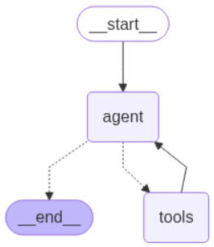
LangGraph Agent System - Architecture
First step, create a single agent system.
Agent responsible for usage of dummy tools.
Test tool calling by different models. [3]
Test output by different models.
Fig. 10 - Single Agent
Speaker: Eduardo (03805057)

Slide 18
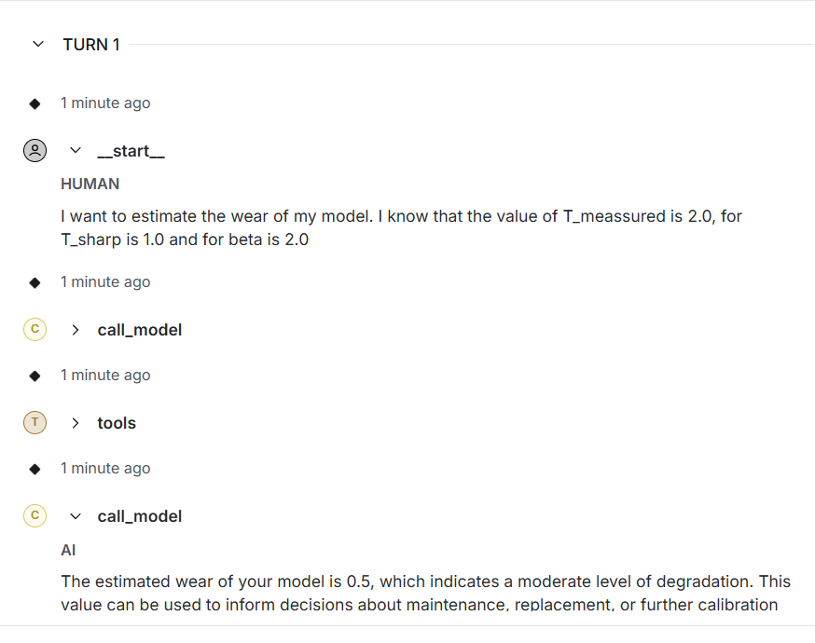
LangGraph Agent System - Results
Model calls the correct tool!
The output from the tool is usually always right since it is basic python tool calling.
ReAct model correctly explains the formula.
Speaker: Eduardo (03805057)

Slide 19
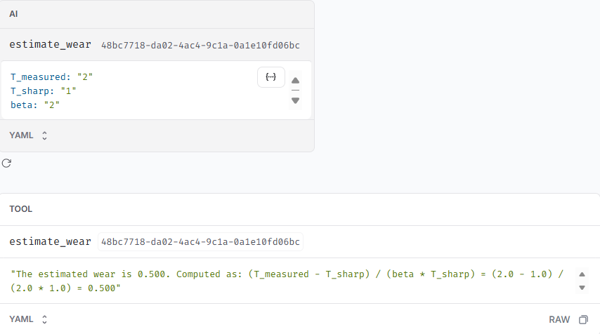
LangGraph Agent System - Results
Possible to check reasoning process of model.
Capture reasoning errors early.
Very important for next step of development.
Speaker: Eduardo (03805057)

Slide 20
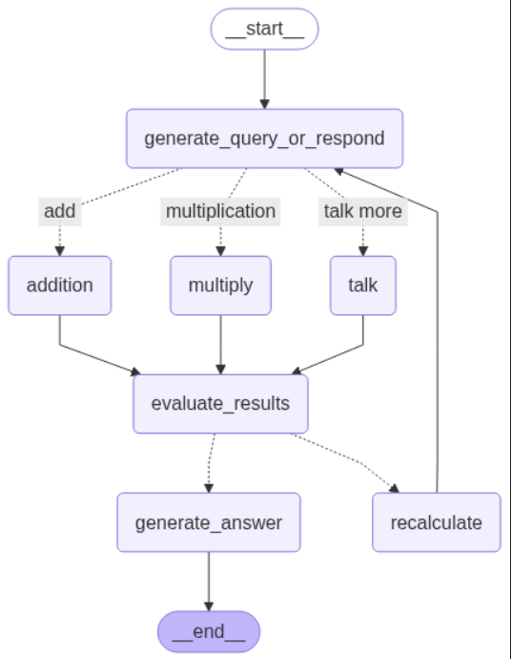
Next Steps
Implement tools for degradation and failure of drilling bit.
Evaluate how to predict quality of drilling based on these aspects.
Expand single-agent calls to multi-agents systems or more complex architectures.
Evaluate Prompt Engineering and Features Importance.
Fig. 11 - Multi-Agent System
Speaker: Eduardo (03805057)

Slide 21
Timeline
Start of Refinement Stage
Evaluate different models and optimization.
“You are here”
Finalize degradation and energy tools.
01/07/2025
01/12/2025
01/09/2025
Second Presentation
Have 1 or 2 tools implemented with LangGraph System
Final Presentation
Present final results
Speaker: Eduardo (03805057)

Slide 22

Documentation and Literature
Refer to our Github to get all the code, reports and documentation!
QR code leads to our Github repository.
Speaker: Eduardo (03805057)

Slide 23
References
[1] - Explainable Artificial Intelligence in Mechanical Engineering: A Synthetic Dataset for Comprehensive Failure Mode Analysis http://dx.doi.org/10.1109/TransAI60598.2023.00032
[2] - Ollama Models Collection, https://github.com/ollama/ollama
[3] - Tool Calling LangGraph, https://langchain-ai.github.io/langgraph/how-tos/tool-calling/#toolnode
References from other presentation already in GitHub!
Speaker: Eduardo (03805057)

